Slide 1
HW-12 Boundless Analytics Test
-Nitin Gowda

Slide 2
Choosing the slices
I manually ran through every single graph of the boundless analytics interface and tried to find the highest value of red plots in every single slice
I then tried to find the highest difference of values between the red plot and the blue plot for every single graph
This led to one slice being picked from every category and then narrowing it down to the most interesting slice.

Slide 3
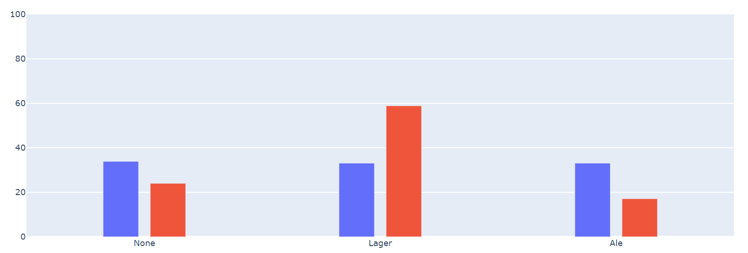
First Slice - beer
I ran through every slice under beer and found the graph with the highest red plot value.
Lager had the highest red plot value of 58.9 and difference between red and blue plots is 25
http://209.97.156.178:8082/?dataset=HomeworkMarket2022&first_attr=Beer&user_filter=%5B%5B%22Day%22%2C%22categorical%22%2C%5B%22Weekend%22%5D%2Cnull%2Cnull%5D%2C%5B%22Location%22%2C%22categorical%22%2C%5B%22New+Brunswick%22%5D%2Cnull%2Cnull%5D%2C%5B%22Snacks%22%2C%22categorical%22%2C%5B%22Crackers%22%5D%2Cnull%2Cnull%5D%5D

Slide 4
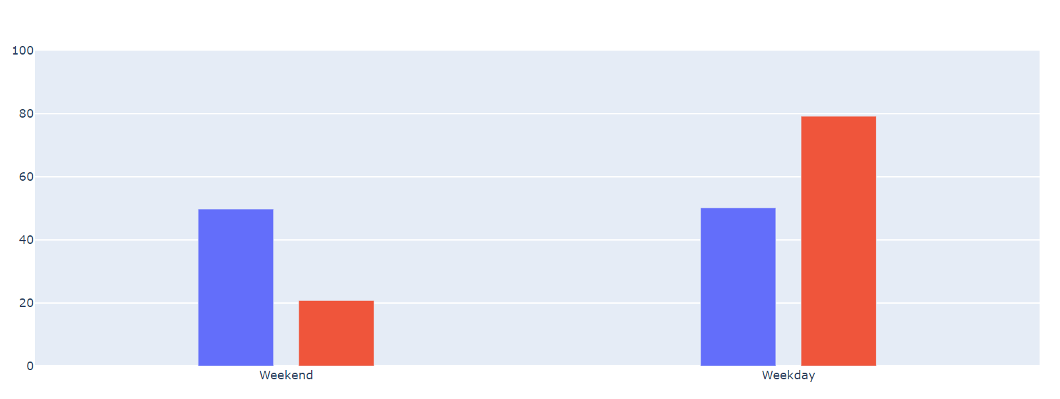
Second slice - day
I ran through every slice under day and found the graph with the highest red plot value.
Weekday had the highest red plot value of 79.2 and difference between red and blue plots was 29
http://209.97.156.178:8082/?dataset=HomeworkMarket2022&first_attr=Day&user_filter=%5B%5B%22Location%22%2C%22categorical%22%2C%5B%22Princeton%22%5D%2Cnull%2Cnull%5D%2C%5B%22Snacks%22%2C%22categorical%22%2C%5B%22Popcorn%22%5D%2Cnull%2Cnull%5D%2C%5B%22SoftDrinks%22%2C%22categorical%22%2C%5B%22Cola%22%5D%2Cnull%2Cnull%5D%5D

Slide 5
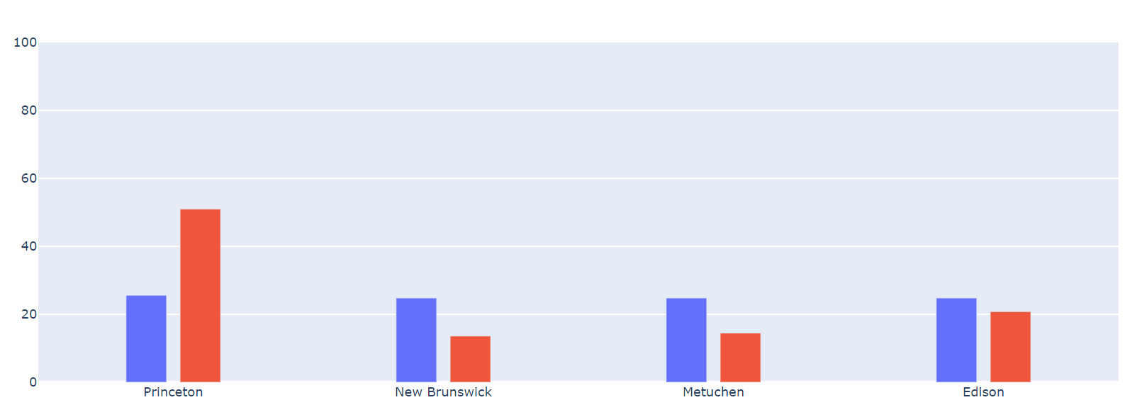
Third slice - location
I ran through every slice under location and found the graph with the highest red plot value.
Princeton had the highest red plot value of 66 and difference between red and blue plots was 25.4
http://209.97.156.178:8082/?dataset=HomeworkMarket2022&first_attr=Location&user_filter=%5B%5B%22Day%22%2C%22categorical%22%2C%5B%22Weekday%22%5D%2Cnull%2Cnull%5D%2C%5B%22Snacks%22%2C%22categorical%22%2C%5B%22Popcorn%22%5D%2Cnull%2Cnull%5D%2C%5B%22SoftDrinks%22%2C%22categorical%22%2C%5B%22Cola%22%5D%2Cnull%2Cnull%5D%5D

Slide 6
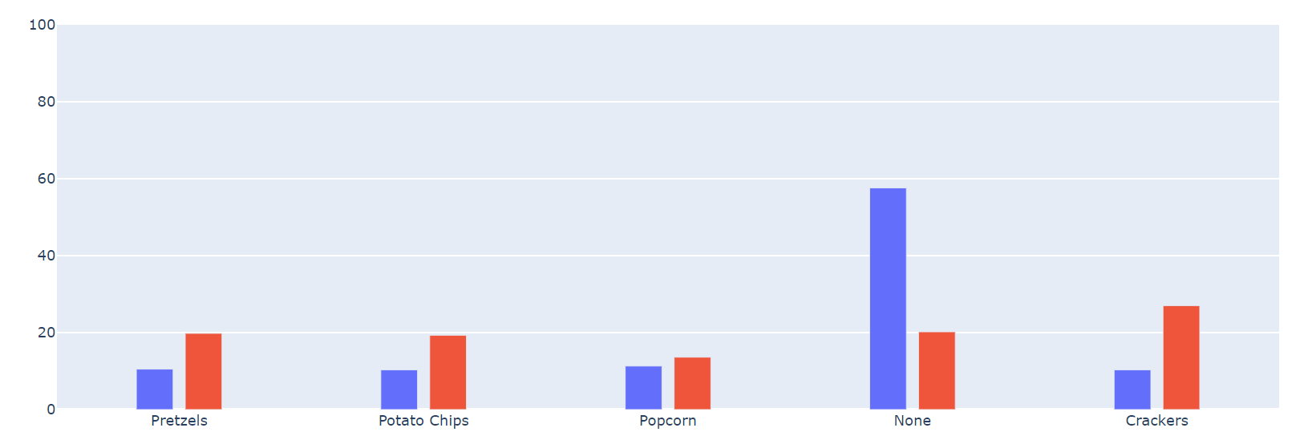
Fourth slice - snacks
I ran through every slice under snacks and found the graph with the highest red plot value.
None had the highest red plot value of 67.3, but I decided to ignore that slice as the difference between red and blue was very low, and therefore chose a new slice which had a red plot value of 20.2 and a difference of 37
http://209.97.156.178:8082/?dataset=HomeworkMarket2022&first_attr=Snacks&user_filter=%5B%5B%22Beer%22%2C%22categorical%22%2C%5B%22Lager%22%5D%2Cnull%2Cnull%5D%2C%5B%22Day%22%2C%22categorical%22%2C%5B%22Weekend%22%5D%2Cnull%2Cnull%5D%2C%5B%22Location%22%2C%22categorical%22%2C%5B%22New+Brunswick%22%5D%2Cnull%2Cnull%5D%5D

Slide 7
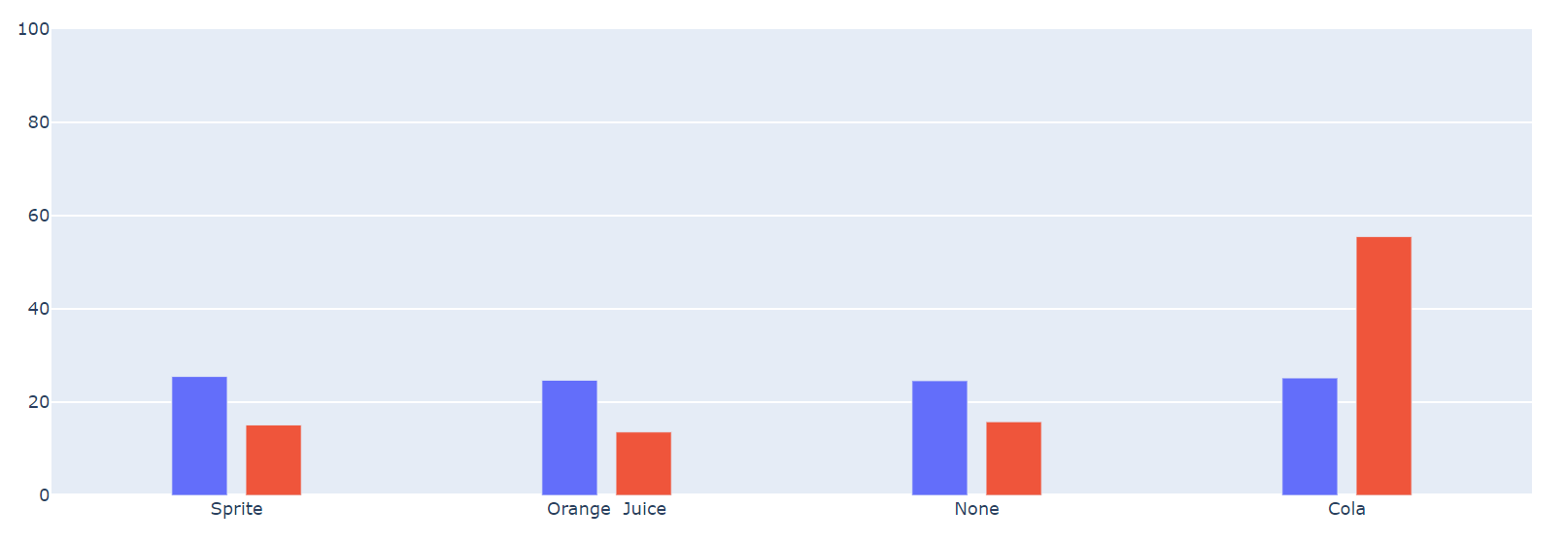
Fifth slice - SoftDrinks
I ran through every slice under SoftDrinks and found the graph with the highest red plot value.
Cola had the highest red plot value of 55.5 and difference between red and blue plots was 30.3
http://209.97.156.178:8082/?dataset=HomeworkMarket2022&first_attr=SoftDrinks&user_filter=%5B%5B%22Day%22%2C%22categorical%22%2C%5B%22Weekday%22%5D%2Cnull%2Cnull%5D%2C%5B%22Location%22%2C%22categorical%22%2C%5B%22Princeton%22%5D%2Cnull%2Cnull%5D%2C%5B%22Snacks%22%2C%22categorical%22%2C%5B%22Popcorn%22%5D%2Cnull%2Cnull%5D%5D

Slide 8
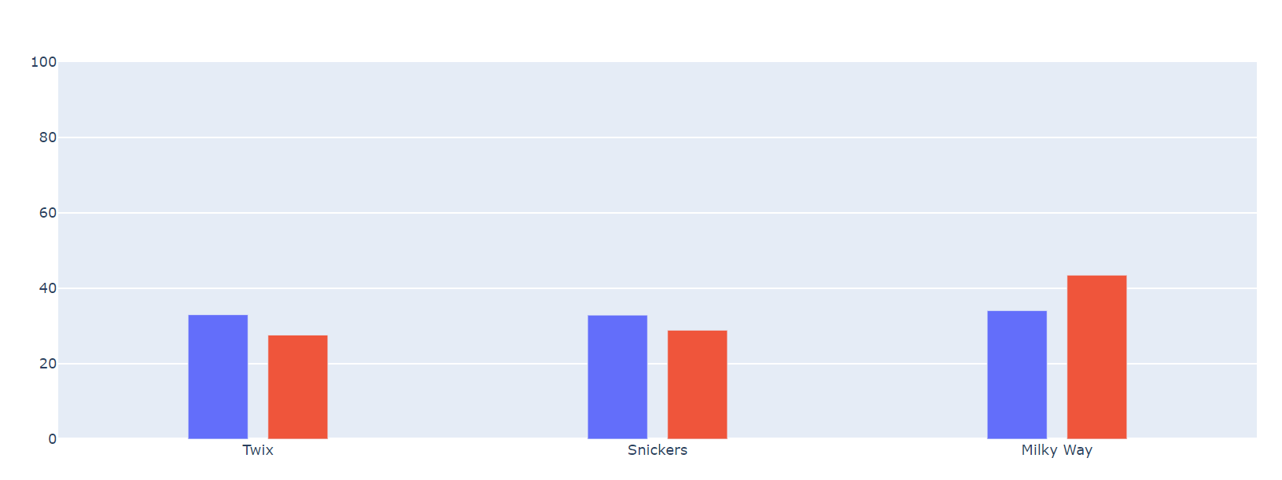
Sixth slice - sweets
I ran through every slice under sweets and found the graph with the highest red plot value.
Milky Way had the highest red plot value of 43.5 and difference between red and blue plots was 9.4
http://209.97.156.178:8082/?dataset=HomeworkMarket2022&first_attr=Sweets&user_filter=%5B%5B%22Day%22%2C%22categorical%22%2C%5B%22Weekday%22%5D%2Cnull%2Cnull%5D%2C%5B%22Snacks%22%2C%22categorical%22%2C%5B%22Potato+Chips%22%5D%2Cnull%2Cnull%5D%2C%5B%22SoftDrinks%22%2C%22categorical%22%2C%5B%22Orange++Juice%22%5D%2Cnull%2Cnull%5D%5D

Slide 9
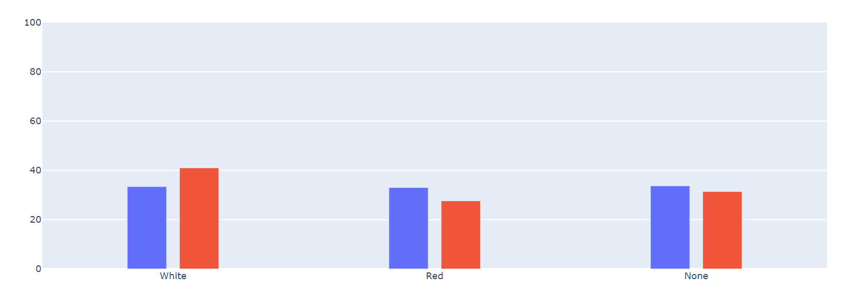
Seventh slice - wine
I ran through every slice under wine and found the graph with the highest red plot value.
White had the highest red plot value of 41 and difference between red and blue plots was 7.6
http://209.97.156.178:8082/?dataset=HomeworkMarket2022&first_attr=Wine&user_filter=%5B%5B%22Beer%22%2C%22categorical%22%2C%5B%22Lager%22%5D%2Cnull%2Cnull%5D%2C%5B%22Snacks%22%2C%22categorical%22%2C%5B%22Pretzels%22%5D%2Cnull%2Cnull%5D%2C%5B%22Sweets%22%2C%22categorical%22%2C%5B%22Snickers%22%5D%2Cnull%2Cnull%5D%5D

Slide 10
Choosing the most interesting slice and finding chi square value
I decided to choose Day as the most interesting slice as Day had the highest total of red plot value and difference of values between red plot and blue plot. It totaled up to 108.2.
For the calculation of chi square value, I used the highest red plot values of the slices which ended up being: Beer – Lager, Day – Weekday and finally, Location – Princeton.
This gave me a chi squared value of 2585.8.

Slide 11
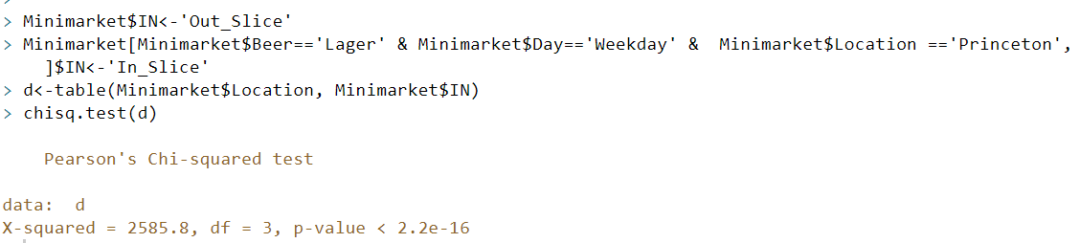
Final Code

Slide 12
Thank you!

